Slide 1
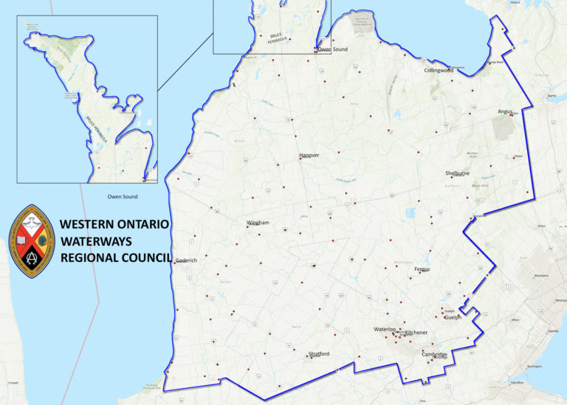
Proposals
WOW President Jennifer Irving talks with Past President Mark Laird about proposals at Regional Council Meetings.

Slide 2
What is a proposal?
A “proposal” is a formal request for a council to take action.
It is one way that a United Church member or court may raise an issue that is important to them and ask for the church to take action on it.
The Manual, 2023, F.1.1 Introduction

Slide 3
Proposal Format
Title:
Origin:
What is the issue?
Why is this issue important?
How might the regional council respond to the issue?

Slide 4
Sample Proposal #1 WESTERN ONTARIO WATERWAYS REGINAL COUNCIL 2023 07 23
Title: Unity in apparel
Origin: Past President
What is the issue?
The combination of the restructuring of The United Church of Canada and a global Pandemic within the first 19 months of the restructuring has led to a sense of loss of identity for the people who make up WOW.

Slide 5
Why is this issue important?
People need to feel connected as one, all pulling in the same direction, rooted in a unity of spirit. For people to want to be a part of an organization, they need to feel like they belong.
WOW needs people to continue to volunteer for different positions to help the COF’s within our bounds. One way we can try to feel together is to wear similar clothes at all regional council meetings. And what better way than to do that than to request that all members wear Toronto Blue Jays apparel during our meetings.
We have a National team for a National Church so we can use the Blue Jays apparel to help to bring us together to feel as one body, with the hope that it will allow us to feel more connected to each other, and feel more a part of WOW.

Slide 6
How might the regional council respond to the issue?
The Regional Council might:
Request that people wear some form of Toronto Blue Jays apparel during all Regional Council meetings, excluding the Celebration of Ministries service.
If someone does not own any Toronto Blue Jays apparel, offer to subsidize the purchase by $20 per individual.

Slide 7
How might the regional council respond to the issue?
The Regional Council might:
Request that people wear some form of Toronto Blue Jays apparel during all Regional Council meetings, excluding the Celebration of Ministries service.
If someone does not own any Toronto Blue Jays apparel, offer to subsidize the purchase by $20 per individual person.

Slide 8
A Proposal …
shares why the issue is important and gives background information
suggests possible ways forward
allows time for the court to ask clarifying questions – unlike with motions, people may ask more than one clarifying question at the discretion of the Chair
allows the court to own the work – through the use of warm and cold cards the Chair can test whether changes might be made that improve the proposal before it becomes a motion
Remember … this is not the time to speak for or against the recommendations

Slide 9
Starting a Proposal
F.1.2.1 Proposals by Member(s) of a Community of Faith
In general, a proposal may be started by any one member of a community of faith, the governing body, a committee, or other church body of a community of faith.
The Manual, 2023
Any member of a community of faith can make a proposal to their congregation's governing body for the Regional Council or General Council. If the governing body agrees, they pass it on to the Regional Council including any recommendations they have. If they disagree, they only pass it on if there is a compelling reason to do so.

Slide 10
Who can send a proposal to WOW?
F.1.2.2. Proposals by Others
A proposal may also be started by
a member of the regional council can submit a proposal [before or during a regional council meeting];
a committee or other church body of the regional council; or
the regional council.
The Manual, 2023

Slide 11
Decisions on Proposals
The council is responsible for making a decision on the proposal. It has the following options:
taking the action requested in the proposal;
taking the action requested in the proposal with some changes;
taking different action on the same subject matter as the proposal;
referring the proposal;
receiving the proposal but taking no further action;
taking some other action that the council of action decides is appropriate.
The Manual, 2023, F.1.4

Slide 12
Proposals to General Council
When the regional council receives the proposal:
The regional council decides if it agrees with the proposal.
If it agrees, the regional council passes the proposal on to the General Council.
If it does not agree, the regional council decides whether or not to pass the proposal on to the General Council. If the regional council does not agree with a proposal, it normally passes it on to the General Council only if there is a compelling reason.
The regional council may include its own recommendations when passing a proposal on to the General Council.
The Manual, 2023, F.1.3.1

Slide 13
Motion
When the Chair discerns the court is ready, the proposal is moved and seconded, and parliamentary procedure is followed.
Any further changes must be made through amendments.
People can only speak to a motion once, except for the mover who may speak at the beginning and end of the discussion.
People are encouraged to only add new information to the conversation rather than repeating what others have said.

Slide 14
Conversation
We are moving to a place where not all work needs to come in the form of proposals or motions.
The sample proposal would be an example of a conversation the Council could have.
The chair, testing the will of the Court with warm and cold cards, could direct the planning team to act on the suggestion for the next meeting without a formal decision.

